Slide 1
Unit -1. ECMA Script 6
Advanced Web Technology
Dept. of Computer Engineering

Slide 2
Content
Introduction
Constants and Scoping,
Enhanced Object Properties,
Arrow Functions
Extended Parameter Handling
Template Literals
Destructuring Assignment
Modules
Classes
Iterators
Generators
Map
Set
Symbols
Promises
Proxies
Reflect API
Tail Recursion Calls

Slide 3
Introduction ES6
JavaScript ES6 (also known as ECMAScript 2015 or ECMAScript 6) is the newer version of JavaScript that was introduced in 2015.
ECMAScript is the standard that JavaScript programming language uses. ECMAScript provides the specification on how JavaScript programming language should work.

Slide 4
Constants
The const declaration creates block-scoped constants, much like variables declared using the let keyword.
The value of a constant can't be changed through reassignment (i.e. by using the assignment operator),
and it can't be redeclared (i.e. through a variable declaration).
However, if a constant is an object or array its properties or items can be updated or removed.

Slide 5
demo
Show the demo for the constants .

Slide 6
Scope
The scope is the current context of execution in which values and expressions are "visible" or can be referenced. If a variable or expression is not in the current scope, it will not be available for use. Scopes can also be layered in a hierarchy, so that child scopes have access to parent scopes, but not vice versa.
JavaScript has the following type of scopes : -
Global scope: The default scope for all code running in script mode.
Block scope: The scope for code running in module mode.
Function scope: The scope created with a function.

Slide 7
Scope
Both let and const keyword belong to block scope which is denoted by curly brace i.e. { }
It cannot be accessed outside the block scope.
Both let and const are new keywords introduced in ES6.
A function creates a scope, so that (for example) a variable defined exclusively within the function cannot be accessed from outside the function or within other functions. Variables declared with var, let and const are same inside function.
For instance, the following is invalid:

Slide 8
Function Scope
function exampleFunc(){
const x = “declared inside function”; //x can be used only inside function
console.log(“Inside function”);
console.log(x);
}
console.log(x); //error will be shown

Slide 9
Global Scope
Variables declared Globally (outside any function) have Global Scope.
Global variables can be accessed from anywhere in a JavaScript program.
Variables declared with var, let and const are quite similar when declared outside a block.

Slide 10
Enhanced Object ES6
Object literal enhancement is used to group variables from the global scope and form them into javascript objects. It is the process of restructuring or putting back together.
Some of the examples of enhanced object in ES6 are as follows :-
// variable declaration
var name = "Duke";
var gender = “male";
var age = 5;

Slide 11
Enhanced Object ES6
// Using Object Literal Enhancement
// Combines all variables into a person object
var person = {name, gender, age};
console.log(person);

Slide 12
Enhanced Object ES6
We can also create object methods with object literal enhancement.
// variable declaration
var name = "Tim";
var gender = “male";
var age = 7;
// function declaration
var sound = function(){
console.log(“hello hi !!");
}
// Using Object Literal Enhancement
// combines all variables into an person object
var person = {name, gender, age, sound};
person.sound();

Slide 13
Enhanced Object ES6
We can also use “this” keyword to access the object keys.
// Variable declaration
var name = "Lilly";
var color = "White";
var age = 3;
// function declaration
// using "this" keyword to access the object keys.
var barkWithName = function(){
console.log('Woof Woof!!, I am '
+this.name+' and I am a '
+this.age+' years old, '
+this.color+ ' coloured dog.Woof Woof!!');
}
// Using Object Literal Enhancement
// combines all variables into a yetAnotherDog object
var yetAnotherDog = {name, color, age, barkWithName};
yetAnotherDog.barkWithName();

Slide 14
Enhanced Object ES6
When defining object methods, it is no longer necessary to use the function keyword. Object literal enhancement allows us to pull global variables into objects and reduces typing by making the function keyword unnecessary.
// New syntax without function keyword
const driver2 = {
name: "Jane",
speed: 60,
car:“Ferrari",
speedUp(speedup){
this.speed = this.speed + speedup;
console.log("new speed = "+ this.speed)
}
}

Slide 15
Arrow Function in ES6
Arrow functions enable us to write functions with simpler and shorter syntax and make our code more readable and organized.
Arrow functions are anonymous functions i.e. they are functions without a name and are not bound by an identifier.
Arrow functions do not return any value and can be declared without the function keyword.
They are also called Lambda Functions.

Slide 16
Arrow Function in ES6
Arrow functions do not have the prototype property like this, arguments, or super.
Arrow functions cannot be used with the new keyword.
Arrow functions cannot be used as constructors.

Slide 17
Arrow Function in ES6
The arrow function is a single liner we needn’t use the return keyword.
// Arrow function for multiplying two numbers
const value = (a, b) => a * b;
console.log(value(3, 5));

Slide 18
Arrow Function in ES6
When there’s a single line of code to be executed we didn’t use the return keyword but if there are more than two lines to be processed, we need to use a return keyword. Example :-
const number = (a, b) => {
c = 5;
return (a + b) * c;
};
console.log(number(2, 3));

Slide 19
Extended Parameters Handling in ES6
Default parameter values and optional parameters
Default parameters allow your functions to have optional arguments without needing to check arguments.length or check for undefined.
let greet = (msg = 'hello', name = 'world') => {
console.log(msg,name);
}
greet();
greet('hey');

Slide 20
Extended Parameters Handling in ES6
Rest parameters (…), indicated by three consecutive dot characters, allow your functions to have a variable number of arguments without using the arguments object. The rest parameter is an instance of Array, so all array methods work. Example :-
function f(x, ...y) {
console.log(x)
console.log(y);
// y is an Array
}
f('hi','hello','bye','have a good day!')

Slide 21
Spread Operator
The spread operator is like the reverse of rest parameters. It allows you to expand an array into multiple formal parameters. Example :-
function add(a, b) {
return a + b;
}
let nums = [5, 4];
console.log(add(...nums));

Slide 22
Template Literals
The template literals were called template strings before the introduction of ES6. Starting from ES6 (ECMAScript 6), we have Template Literals which are indicated by the backtick (` `) character. Template literals can also be used to hold the placeholders, that are indicated by the ‘$’ sign and the {} braces such as (${expression}).

Slide 23
Template Literals
Example :-
const str1 = `Hi, I am a Learner`;
console.log(str1);
const str = "I am a learner in Marwadi University";
const str2 = `Hi, ${str} Gujarat`;
console.log(str2);

Slide 24
Destructuring
Destructuring is an efficient way to extract multiple values from data that is stored in arrays or objects. When destructuring an array, we use their positions (or index) in an assignment.
Example:-
var arr = ["Hello", "World"]
// destructuring assignment
var [first, second] = arr;
console.log(first); // Hello
console.log(second); // World

Slide 25
Destructuring
Destructuring can also be done with Rest operator .
Example :-
var colors = ["Violet", "Indigo", "Blue", "Green", "Yellow", "Orange", "Red"];
// destructuring assignment
var [a,b,...args] = colors;
console.log(a);
console.log(b);
console.log(args);

Slide 26
Destructuring Object
It is similar to array destructuring except that instead of values being pulled out of an array, the properties (or keys) and their corresponding values can be pulled out from an object.
When destructuring the objects, we use keys as the name of the variable. The variable name must match the property (or keys) name of the object. If it does not match, then it receives an undefined value. This is how JavaScript knows which property of the object we want to assign.
In object destructuring, the values are extracted by the keys instead of position (or index).

Slide 27
Destructuring Object
Example :-
const student = {name: 'Arun', position: 'First', rollno: '24'};
const {name, position, rollno} = student;
console.log(name); // Arun
console.log(position); // First
console.log(rollno); // 24

Slide 28
Modules
Modules in JavaScript helps to modularize the code by partitioning the entire code into various modules which can be imported from anywhere and thus used. It makes it easy to reuse a piece of code, maintain code and debug code.
Exporting Values: JavaScript because of its multi-paradigm nature allows us to export functions, objects, classes and primitive values using the keyword export.

Slide 29
Modules
Named Exports: Any function, class or variable exported using the named export can only be imported using the same name. Multiple functions and variables can be exported and imported using named export.
Default Exports: Anything exported as a default can be imported using any name. A maximum of 1 value can be exported using the default export. To export multiple values, one can combine them in an object and then use default export to export this object.

Slide 30
Modules example export
Example :- products.mjs file
// Module products.mjs
var numberSale=0;
var totalSale=0;
// Export keyword can be specified individually
// with functions and variables.
export function buy(buyer, item)
{
buyer.total=buyer.total+item.price;
}
export function sell(item)
{
totalSale=totalSale+item.price;
numberSale=numberSale+1;
item.quantity=item.quantity-1;
return 0;
}
// Export keyword can also be used
// with multiple values.
export { totalSale, numberSale};

Slide 31
Module example import
import {total sale, numberSale, buy, sell } from './product.mjs';
let buyer={
name:“Mike",
total:0
};
let item={
name="butter",
price:10,
quantity:100
};
console.log("Total Sale till now = ",totalSale);
buy(buyer, item); //imported function
sell(item); //imported function
console.log("Total expense of buyer = ",buyer.total);
console.log("Quantity of item left = ",item.quantity);
console.log("Total Sale till now = ",totalSale);

Slide 32
Module example default
Example:
// Module secret_ingredient.mjs
var secretIngredient="Salsa";
export default secretIngredient;

Slide 33
Module
Importing Values: Only the values exported from a module can be imported using the import keyword.
Example :-
import { buy, sell} from './modules/products.mjs';

Slide 34
Classes in ES6
There are three concepts in Object-Oriented Programming Object, Class, and Methods. ES6 JavaScript supports Object-Oriented programming components.
Object: A real-time object entity means the presentation of any entity in real-time.
Class: It is the before the plan of creating any objects which is known as the blueprint of any objects which you want to create.
Methods: It communicates between the objects.

Slide 35
Classes
Example :-
class gfg {
// Constructor
constructor(name, estd, rank) {
this.n = name;
this.e = estd;
this.r = rank;
}
// Function
decreaserank() {
this.r -= 1;
}
}
const geeks = new gfg("geeks", 2009, 43)
geeks.decreaserank();
console.log(geeks.r); //Output 42

Slide 36
Iterators
Javascript Iterator is an object or pattern that allows us to traverse over a list or collection. Iterators define the sequences and implement the iterator protocol that returns an object by using a next() method that contains the value and is done.
The value contains the next value of the iterator sequence and the done is the boolean value true or false if the last value of the sequence has been consumed then it’s true else false.

Slide 37
Iterators
In Array.prototype you will find Symbol(Symbol.iterator): ƒ values() method. The array is by default iterable. Also, String, Map & Set are built-in iterables because their prototype objects all have a Symbol.iterator() method.

Slide 38
Iterators Example
const array = ['a', 'b', 'c'];
const it = array[Symbol.iterator]();
// and on this iterator method we have ‘next’ method
console.log(it.next());
//{ value: "a", done: false }
console.log((it.next());
//{ value: "b", done: false }
console.log((it.next());
//{ value: "c", done: false }
console.log((it.next());
/* Actual it.next() will be { value: undefined,
done: true } but here you will get
{done: true} output because of JSON.stringify
as it omits undefined values*/

Slide 39
Generators
The ES6 generator is a new type of function that can be paused in the middle or many times in the middle and resumed later.
In the standard function, control remains with the called function until it returns, but the generator function in ES6 allows the caller function to control the execution of a called function.

Slide 40
Generators
The difference between a generator and a regular function is:
In response to a generator call, its code doesn’t run. In its place, it returns a special object called a ‘Generator Object’ to manage the execution.
At any time, the generator function can return (or yield) the control back to the caller.
The generator can return (or yield) multiple values according to the requirement, unlike a regular function.

Slide 41
Generators
Syntax: Generator functions have a similar syntax to regular functions. As the only difference, the generator function is denoted by an asterisk (*) after the function keyword.
function *myfunction() { }

Slide 42
Generators
Yield operator: In the yield statement, function execution is suspended and a value is returned to the caller. In this case, enough state is retained for the function to resume where it left off. Following the last yield run, the function resumes execution immediately after it has been resumed. We can produce a series of values using this function.

Slide 43
Generators
JavaScript next method: The next() method will resume the execution of the generator function when it receives an argument, replacing the yielded expression where the execution was paused with the argument from the next() method. Objects returned by the next() method always have two properties.
value-The yielded value is the value.
done- The completed state of a function can be expressed as a Boolean value true. Otherwise, it yields false.

Slide 44
Generators
Example :-
function *generator() {
yield 1;
yield 2;
yield 3;
}
let obj = generator();
console.log(obj.next());
console.log(obj.next());
console.log(obj.next());
console.log(obj.next());

Slide 45
Generators
Return statement in a generator function: A return statement sends a specified value back to its caller. It ends the execution of the function call and returns the result to the caller. The statements defined after the return statement are not executed in a function. Therefore, the return statement should come at the end of the function.

Slide 46
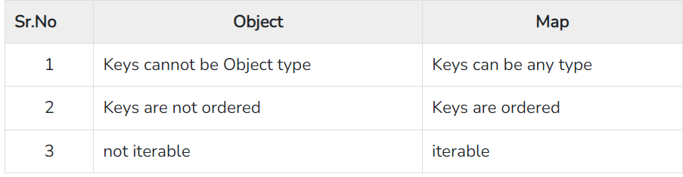
Maps
A map is an ordered collection of key-value pairs. Maps are similar to objects. However, there are some differences between maps and objects. These are listed below −

Slide 47
Maps
Syntax
The syntax for Map is given below −
let map = new Map([iterable])
let map = new Map()

Slide 48
Maps
Example:-
const map = new Map();
map.set('a', 1);
map.set('b', 2);
map.set('c', 3);
for (const[key ,value] of map) {
console.log( key ,value);
}

Slide 49
Maps
1. set(key,value)
Adds key and value to map
2. get(key)
Returns value if key is matched
3. has(key)
Returns true if an element with the specified key exists; else returns false
4. keys()
Returns an iterator that contains the keys for each element in the map object
5. values()
Returns an iterator that contains the values for each element in the map object
6. entries()
Returns an iterator that contains the key-value pairs for each element in the Map
7. delete(key)
Removes the specified element from a Map object

Slide 50
Maps
Refer to this link for Maps:
https://www.tutorialspoint.com/es6/es6_maps_and_sets.htm

Slide 51
WeakMap
WeakMap is a small subset of map. Keys are weakly referenced, so it can be non-primitive only. If there are no reference to the object keys, it will be subject to garbage collection.
not iterable
every key is object type
The WeakMap will allow garbage collection if the key has no reference.

Slide 52
WeakMap
Example :-
// Create a WeakMap
const map = new WeakMap();
// Create some objects
const obj1 = {};
// Set key-value pairs in the WeakMap
map.set(obj1, 'Value 1');
// Retrieve values from the WeakMap
console.log(map.get(obj1)); // Output: Value 1
// Check if a key exists in the WeakMap
console.log(map.has(obj1)); // Output: true
// Remove a key-value pair from the WeakMap
map.delete(obj1);
// Check if the key still exists
console.log(map.has(obj1)); //

Slide 53
Set
A set is an unordered collection of unique values. This data structure can contain values of primitive and object types.
Syntax
The syntax for Set is given below −
new Set([iterable])
new Set()

Slide 54
Set
Example :-
let names = new Set(['A','B','C','D']);
console.log(names)
Example (size) :-
let names = new Set(['A','B','C','D']);
console.log(names.size)

Slide 55
Iterating Set
Example :-
let names= new Set(['A','B','C','D']);
//iterate using forEach
console.log('forEach')
names.forEach(n=>console.log(n))
console.log('for of..')
//iterate using for..of
for(let n of names){
console.log(n)
}

Slide 56
Set Operations
1. add(element)
Adds an element to the Set
2. has(element)
Returns true if element found; else returns false
3. delete(element)
Delete specific element from the Set
4. clear()
Clears all elements from the Set

Slide 57
WeakSet
A Weakset holds objects weakly, that means object stored in a WeakSet are subject to garbage collection, if they are not referenced. WeakSets are not iterable and do not have the get method.

Slide 58
WeakSet
Example :-
let e1 = {ename:'A'}
let e2 ={ename:'B'}
let e3 ={ename:'C'}
let emps = new WeakSet();
emps.add(e1);
emps.add(e2)
.add(e3);
console.log(emps)
console.log(emps.has(e1))
emps.delete(e1);
console.log(emps)

Slide 59
Symbol
ES6 introduces a new primitive type called Symbol. They are helpful to implement metaprogramming in JavaScript programs.
Syntax
const mySymbol = Symbol()
const mySymbol = Symbol(stringDescription)
A symbol is just a piece of memory in which you can store some data. Each symbol will point to a different memory location. Values returned by a Symbol() constructor are unique and immutable.

Slide 60
Symbol
Example :-
const s1 = Symbol();
const s2 = Symbol();
console.log(typeof s1)
console.log(s1===s2)
const s3 = Symbol("hello");//description
const s4 = Symbol("hello");
console.log(s3)
console.log(s4)
console.log(s3==s4)

Slide 61
Promises
p is the promise object, resolve is the function that should be called when the promise executes successfully and reject is the function that should be called when the promise encounters an error.
A Promise is an object representing the eventual completion or failure of an asynchronous operation.

Slide 62
Example Promises
const myPromise = new Promise((resolve,reject)=>{
let done = false
if(done){
resolve('The work is done!')
}
else{
reject('the work is not done!')
}
})
myPromise.then((res)=>{
console.log('result>> ',res)
})
.catch((err)=>{
console.log('result>> ',err )
})

Slide 63
Promises Chaining
Promises chaining can be used when we have a sequence of asynchronous tasks to be done one after another. Promises are chained when a promise depends on the result of another promise.
function asyncTask1(x){
return new Promise((resolve,reject)=>{
if( x>5 ){
resolve("successful !")
}
else {
reject("unsuccessful !")
}
})
}

Slide 64
Promises Chaining
function asyncTask2(x){
return new Promise((resolve,reject)=>{
if(x==true){
resolve("successful !")
}
else {
reject("unsuccessful !")
}
})
}

Slide 65
Promises Chaining
// Chain the promises
asyncTask1(7)
.then(() => asyncTask2(true))
.then(() => {
console.log('All tasks completed');
})
.catch((error) => {
console.error('An error occurred:', error);
});

Slide 66
Reflect API
ES6 introduces new features around meta-programming which involves inspecting or modifying the structure of the program, or changing the way things work in the language itself.
Introspection − Introspection means a program gathering information about itself. Some examples of JavaScript operators that are used for introspection are typeof, instanceof etc.
Self-modification − Self-modification refers to modifying the structure of a program at runtime. It involves accessing or creating new properties at runtime. In other words, self-modification is when some code modifies itself.
Intercession − refers to code modifying the default behavior of a programming language. Intercession involves modifying semantics of the programming language or adding new constructs to the program at runtime.

Slide 67
Reflect API
Reflect API in ES6 allows us to inspect, or modify classes, objects, properties, and methods of a program at runtime. The Reflect API provides global Reflect object which has static methods that can be used for introspection.
These methods are used to discover low level information about the code. The Reflect API can be used to build automation testing frameworks that examine and introspect program at runtime.

Slide 68
Reflect API
1. Reflect.apply()
Calls a target function with arguments as specified by the args parameter
2. Reflect.construct()
Equivalent to calling new target(...args) objects of a class
3. Reflect.get()
A function that returns the value of properties.
4. Reflect.set()
A function that assigns values to properties. Returns a Boolean that is true if the update was successful.
5. Reflect.has()
The in operator as function. Returns a Boolean indicating whether an own or inherited property exists.
https://www.tutorialspoint.com/es6/es6_reflect_api.htm

Slide 69
Proxy API
ES6 implements intercession form of meta programming using Proxies. Similar to ReflectAPI, the Proxy API is another way of implementing meta programming in ES6.
The Proxy object is used to define custom behavior for fundamental operations.
A proxy object performs some operations on behalf of the real object.

Slide 70
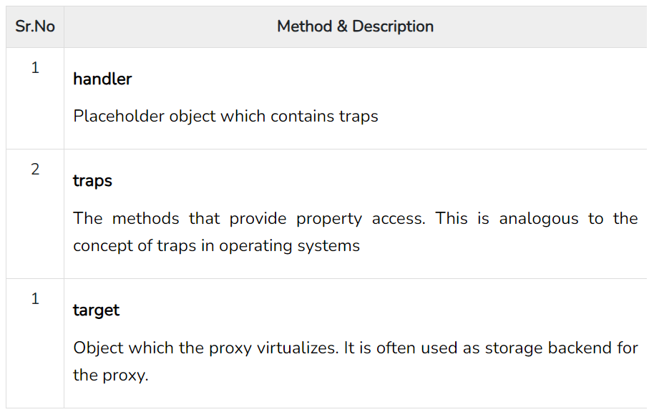
Proxy API

Slide 71
Proxy API
Syntax
The syntax stated below is for the Proxy API, where, target can be any sort of object like array, function or another proxy and handler is an object whose properties are functions. This defines the behavior of the proxy.
const proxy = new Proxy(target,handler)
Handler Methods
The handler object contains traps for Proxy. All traps are optional. If a trap has not been defined, the default behavior is to forward the operation to the target.

Slide 72
Proxy Api
const target = {
name: 'John',
age: 30
};
const handler = {
get(target, property, receiver) {
console.log(`Accessed property: ${property}`);
return target[property];
}
};
const proxy = new Proxy(target, handler);
console.log(proxy.name); // Output: Accessed property: name, John
console.log(proxy.age); // Output: Accessed property: age, 30

Slide 73
Proxy API
1. handler.apply()
A trap for a function call.
2. handler.construct()
A trap for the new operator.
3. handler.get()
A trap for getting property values.
4. handler.set()
A trap for setting property values.
5. handler.has()
TA trap for the in operator.

Slide 74
Tail Recursion
Tail recursion is defined as a recursive function in which the recursive call is the last statement that is executed by the function. So basically nothing is left to execute after the recursion call.
Example:-
function id(x) {
return x; // line(A)
}
function f(a) {
let b = a + 1;
return id(b); // line(B)
}
console.log(f(2)); // line(C)
Here line(C) can be omitted and line(B) can be the tail call

Slide 75
Tail Recursion Call
Example :-
function factorial(n) {
return facRec(n, 1);
}
function facRec(x, acc) {
if (x <= 1) {
return acc;
} else {
return facRec(x-1, x*acc); // (A)
}
}
*Here facRec line(A) is the tail recursion call

Slide 76
Thank You

